Slide 1
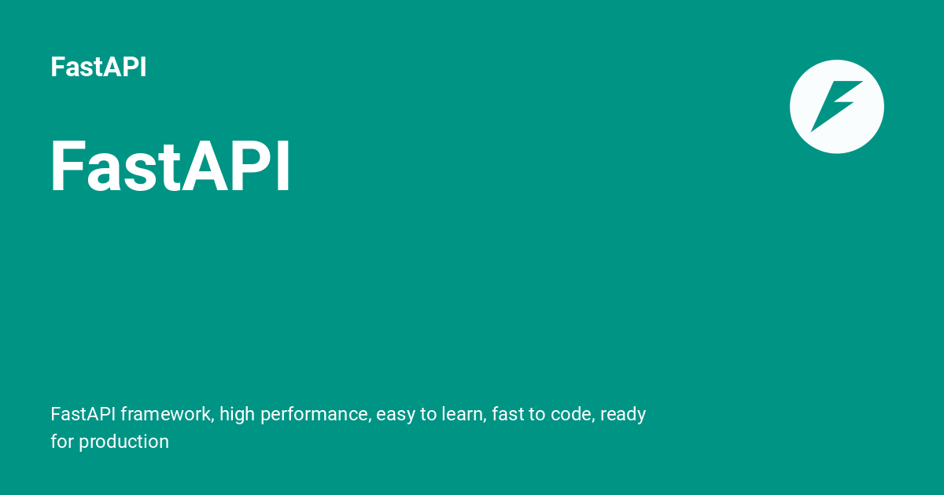

Slide 2
FastAPI?
FastAPI is a modern, high-performance web framework for building APIs using Python. It is built on top of:
Starlette → for web handling (requests, routing, etc.)
Pydantic → for data validation and serialization
It’s called FastAPI because it’s one of the fastest Python frameworks, comparable to Node.js and Go in performance.

